Slide 1
Classical Machine Learning Algorithms for Classifying Protest Related News
Fatih Beyhan
https://github.com/fatihbeyhan/ProtestClassifier

Slide 2
Outline
Introduction
Dataset
Preprocessing and Analysis
Models and Results
What did work?
What did not work?
Conclusion
Further Work

Slide 3
Introduction
What is the main challenge that we should tackle?
Notes:
Unknown feature space. Unknown dataset.

Slide 4
Dataset
URLs and Labels.
newspaper library.
The location and time.
Notes:
BeautifulSoup first then newspaper. Which sections did you extracted? Which one you will use? Locations and Time?

Slide 5
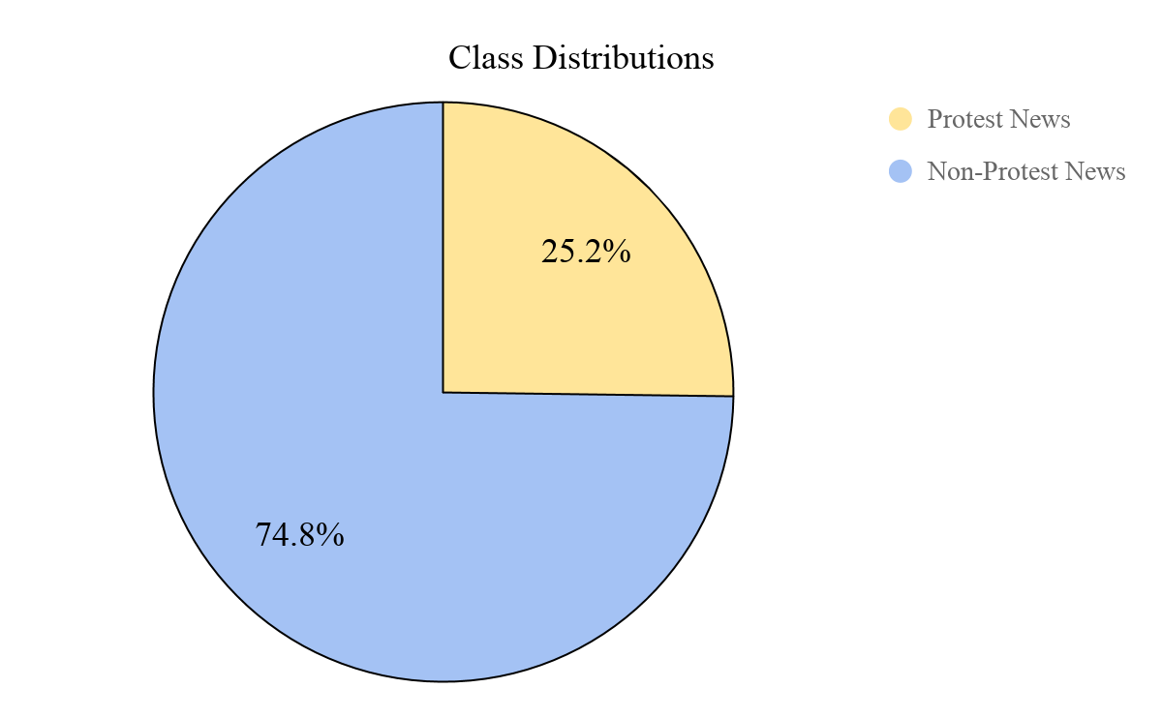
Dataset
774 News.
Imbalanced data.
Notes:
We have imbalanced data. That’s challenge for us.

Slide 6
Preprocessing and Analysis
 | Avg. # of Sent. | Avg. # of Words | Max & Min # of Sent. | Max & Min # of Words
Protest News | 15.13 | 225.50 | 60 & 3 | 1520 & 29
Non-Protest N. | 19.82 | 263.93 | 170 & 3 | 1245 & 22
All News | 18.63 | 254.25 | 170 & 3 | 1520 & 22
Notes:
You can see the blablabla on this table before any preprocessing. Basically, whether an article is about a protest or not will be predicted from approximately 19 sentences and 260 words.

Slide 7
Preprocessing and Analysis
Protest News | Non-Protest News | All News
‘state’ - 0.43 | ‘government’ - 0.25 | ‘government’ - 0.30
‘government’ - 0.43 | ‘state’ - 0.24 | ‘state’ - 0.28
‘district’ - 0.42 | ‘year’ - 0.24 | ‘district’ - 0.24
‘protest’ - 0.41 | ‘take’ - 0.21 | ‘year’ - 0.22
‘police’ - 0.40 | ‘time’ - 0.21 | ‘minister’ - 0.21

Slide 8
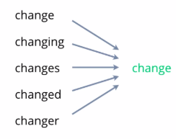
Preprocessing and Analysis
Computers do not understand words.
Stopwords & Lemmatization.
TFIDF Vectorizer.
Document → Vector
Train & Test (0.3)
Notes:
The tfidf mistake. Add tfidf to grid pipeline. 3k dimensional vector for each.

Slide 9
Models
What did work?

Slide 10
Classical Models
LogisticRegression()
Pipeline
TFIDF.
Classifier.
GridSearchCV
F1-Macro
SVC()
KNeighborsClassifier()
Notes:
The difference between macro and micro averaging for performance metrics (such as the F1-score) is that macro weighs each class equally whereas micro weights each sample equally. If the distribution of classes is symmetrical (i.e. you have an equal number of samples for each class), then macro and micro will result in the same score.

Slide 11
Best Models & Results
LogisticRegression()
{'clf__C': 15, 'tfidf__min_df': 4, 'tfidf__ngram_range': (1, 2)}
 | Precision | Recall | F1-Score | Support
0.0 | 0.88 | 0.98 | 0.92 | 174
1.0 | 0.90 | 0.59 | 0.71 | 59
Accuracy |  |  | 0.88 | 233
Macro avg. | 0.89 | 0.79 | 0.82 | 233
Weighted avg. | 0.88 | 0.88 | 0.87 | 233

Slide 12
Best Models & Results
SVC()
{'clf__C': 5, 'clf__gamma': 'scale', 'clf__kernel': 'linear',
'tfidf__min_df': 4, 'tfidf__ngram_range': (1, 2)}
 | Precision | Recall | F1-Score | Support
0.0 | 0.90 | 0.98 | 0.94 | 174
1.0 | 0.91 | 0.69 | 0.79 | 59
Accuracy |  |  | 0.91 | 233
Macro avg. | 0.91 | 0.84 | 0.86 | 233
Weighted avg. | 0.91 | 0.91 | 0.90 | 233

Slide 13
UNDERSAMPLING?

Slide 14
Best Models & Results
LogisticRegression()
{'clf__C': 15, 'tfidf__min_df': 4, 'tfidf__ngram_range': (1, 3)}
 | Precision | Recall | F1-Score | Support
0.0 | 0.89 | 0.86 | 0.87 | 63
1.0 | 0.84 | 0.87 | 0.85 | 54
Accuracy |  |  | 0.86 | 117
Macro avg. | 0.86 | 0.86 | 0.86 | 117
Weighted avg. | 0.86 | 0.86 | 0.86 | 117

Slide 15
Best Models & Results
SVC()
{'clf__C': 1.0, 'clf__kernel': 'sigmoid',
'tfidf__min_df': 4, 'tfidf__ngram_range': (1, 2)}
 | Precision | Recall | F1-Score | Support
0.0 | 0.89 | 0.86 | 0.87 | 63
1.0 | 0.84 | 0.87 | 0.85 | 54
Accuracy |  |  | 0.86 | 117
Macro avg. | 0.86 | 0.86 | 0.86 | 117
Weighted avg. | 0.86 | 0.86 | 0.86 | 117

Slide 16
Test Results
 | Precision | Recall | F1-Score | Support
0 | 0.93 | 0.95 | 0.94 | 943
1 | 0.51 | 0.41 | 0.45 | 107
Accuracy |  |  | 0.90 | 1050
Macro Avg | 0.72 | 0.68 | 0.70 | 1050
Weighted Avg | 0.89 | 0.90 | 0.89 | 1050

Slide 17
Models
What did not work?

Slide 18
Models
Neural Network (PCA).
BERT ForSequenceClassification (fine-tuning).
LDA.
Doc2Vec.
41 Words.

Slide 19
Conclusion
With a small and imbalanced dataset, the best approach was the Support Vector Machine with original dataset for protest classifier. Although transformers are sweeping the all tasks on NLP, it did not help on this specific dataset, however, a larger and healthier dataset would make BERT model give excellent results. Nevertheless, if our dataset is divisible by simple models, there is no need to use complex models. Nobody wants to cut a bread with a lightsaber.

Slide 20
Further Work
Create a mix dataset from different sources and contexts.
A model which will keep the semantic relationships.
Word Embeddings.

